Slide 1
Singapore’s Business History Banking in Singapore: Lecture Outline
Traditional Sources of Finance
Coming of the European Banks
Rise of Chinese Banks
Dialect Based Banking
Problems in Chinese Banking
Role in Economic & Financial Development
Characteristics of Pre WWII Banking
Financial Structures, 1950s-1960s
Emergence of Singapore as an International Financial Centre 1970s & beyond

Slide 2
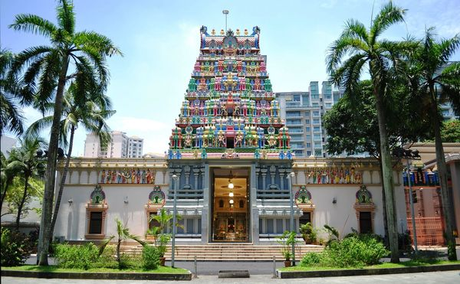
Traditional Sources of Finance
Chettiar Money-lenders
Rotating credit and Savings Associations
Pawnshops (Hokkien and Teochew dominated)
Remittance houses (Hokkien and Teochew dominated)
Overall paucity of sources of credit

Slide 3
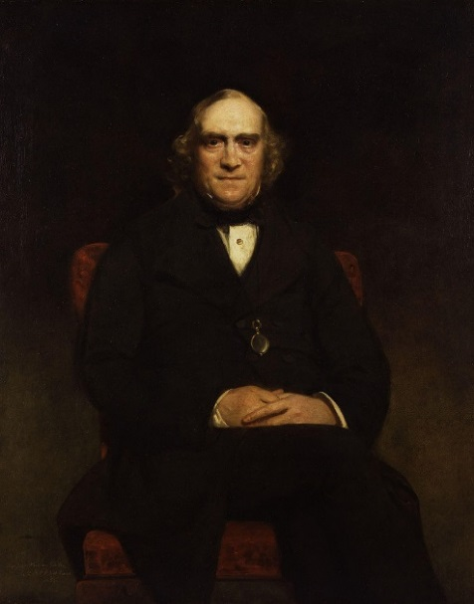
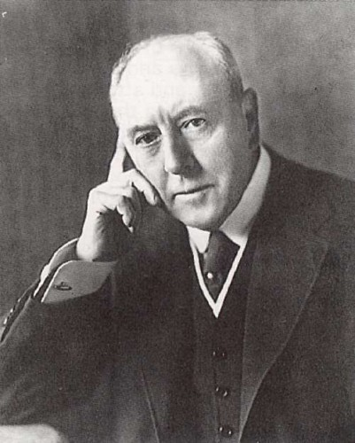
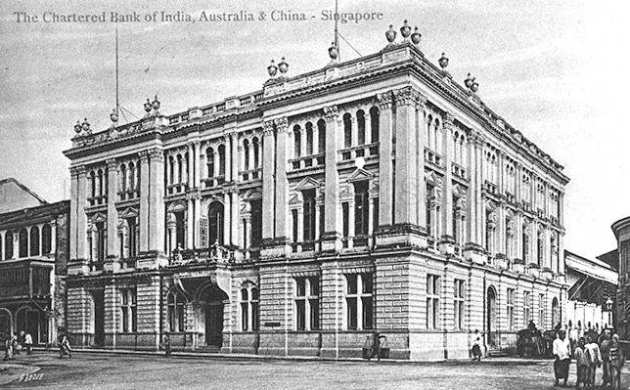
European Banks (I)
Earliest Banks
Union Bank of Calcutta (1840)
Commercial Bank of India (Cowasjee Nanbhoy, 1850s)
Chartered Mercantile Bank of India, London and China
Bombay Roots (Cowasjee Nanabhoy)
1856
Chartered Bank of India, Australia and China
James Wilson
1859
Hongkong and Shanghai Banking Corporation
Sir Thomas Sutherland, P & O
James Wilson
Thomas Sutherland

Slide 4
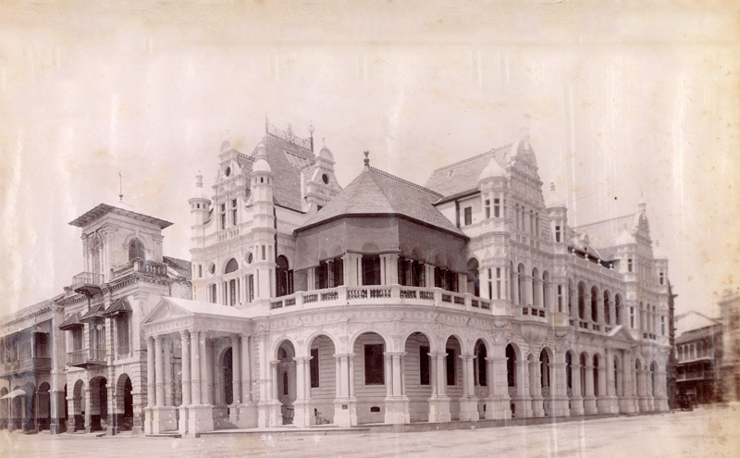
European Banks (II)
Role of European banks
Financiers of Trade
Government Bankers
Issue of Currency notes (1906 Adoption of sterling standard)
Exchange Banks (till late 19th c)
From late 19th c- finance for exports
Manager of the Mercantile Bank: ‘We finance the exports of the Colony as a matter of course; that is what we are here for. We never refuse to buy a bill against exports of produce unless it is with people unfit to be traded with.’
HSBC 1st office 1892 , Colliers Quay
Source: HSBC web site

Slide 5
European Banks (III)
Limited role in Financial Development
Not responsible for early development of trade
Singapore’s capital market remained week (pre WWII) and fragmented
Relations with Local Money-lenders/ Chinese Banks
Reliance on local traders for contacts
Chinese Banks – conservative reserve ratio policies
Deposited reserves; large portions of capital in European Banks
50 per cent of their current account

Slide 6
Early Chinese Banks
Kwong Yik Bank (1903) : Gambier connection
Sze Hai Tong Bank (1906): renamed Four Seas Communications Bank
Ban Hin Lee Bank (1918)
Lee Wah Bank
Remittance business
Straits Times, 21 Nov 2013. National Archives collection/ NLB

Slide 7
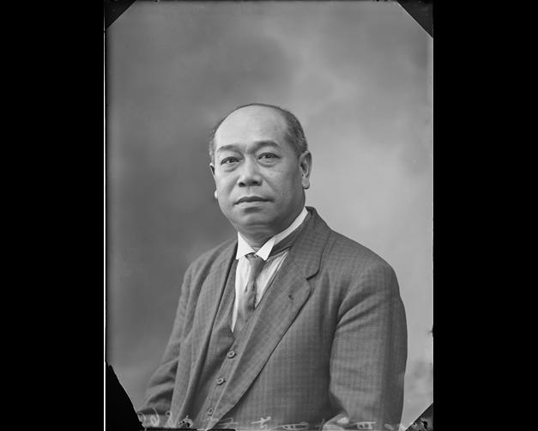
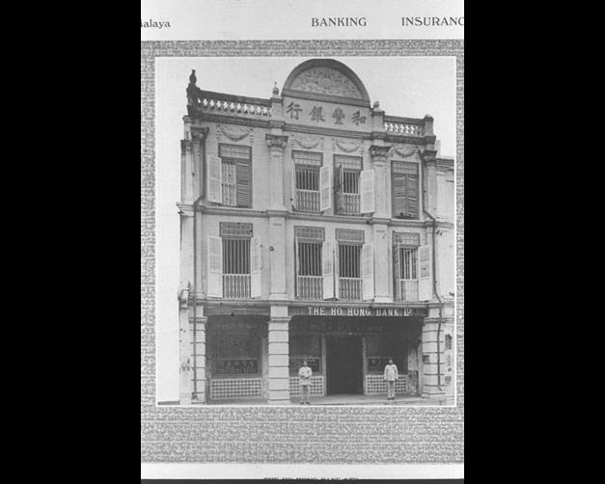
Early 20th Century: Rise of deposit banks
Chinese Commercial Bank 1912
Paid up capital of 1 million Dollars
Ho Hong Bank 1917
Paid up capital of 2 million dollars
Oversea- Chinese bank 1919
Paid up capital of 5.25 million dollars
1932 Oversea Chinese Banking corporation OCBC
Largest Chinese owned bank outside China
Branches throughout Southeast Asia and China
Lee Choon Guan (1868–1924), co-founded the Chinese Commercial Bank in 1912.
(National Archives Collection)
(Ho Hong Bank National Archives Collection)

Slide 8
Role of the Chinese Banks in the Financial Development of Singapore (I)
Problems faced by early Chinese banks
Limited Assets
Risk of contractions in money supply
No central bank; lack of access to large credit market
Role in development of Trade
Asian traders & Foreign banks
1896 less than 50 Chinese traders had European banks accounts
During the War: ‘The European banks had an aura about them which intimated local people (and) would not accept small amounts.’
Provided an efficient way of mobilising Chinese / local savings for productive investment
Role in integrating credit and capital markets

Slide 9
Role of the early Chinese Banks in the Financial Development of Singapore (II)
Popularised current account system among merchants and shopkeepers
Spread the banking habit ; 1933 chairman, OCBC: ‘Most of our customers are Chinese merchants who have only in recent years lent to make use of banking facilities.’
Worked with insurance companies in fire, marine workmen’s compensation
Mobilised working class savings
Gave loans for industrial investment

Slide 10
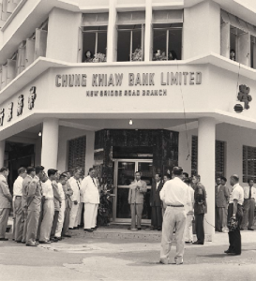
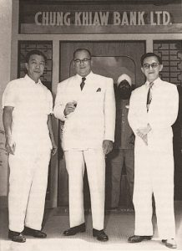
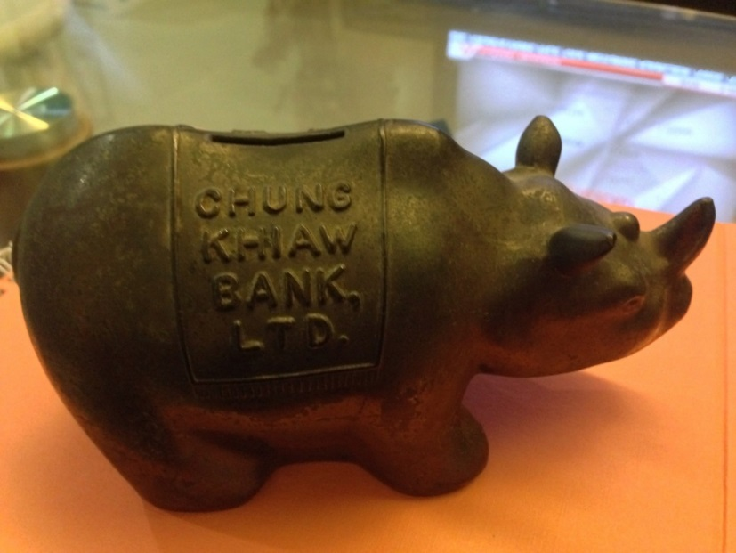
Chung Khiaw Bank Aw Boon Haw ‘It is our intention to help the middle & lower classes- to give them a break – we will finance the small man, thus helping him …’ Aw Boon Haw - 1950 interview ‘Small Man’s Bank’ 1971: UOB
Managing Director Lee Chee San
At branch opening, 1958
Source: Biblioasia

Slide 11
Characteristics of Banking in Pre-World War II Singapore (I)
Complimentary Banking systems
Separate constituencies
Chinese Banks, European banks and Informal Financiers
Problems faced by Chinese Banks
Structure & Organization
Over lending & non repayment of loans (Tan Kah Kee)
Lacked internal controls
Hiring issues
Impact of the Great Depression

Slide 12
Characteristics of Banking in Pre-World War II Singapore (II)
European banks: not responsible for making Singapore an independent financial centre
Finance for exports / primary commodity traded
Capital Market : weak and fragmented
Manager of the Chartered bank: ‘The question of financing industry has never really arisen in Singapore’
Asian entrepreneurs borrowed from Chinese banks and the informal sector
Lack of strong credit market

Slide 13
Financial Structures, 1950s-1960s
Informal Economy: Moneylenders; Chettiars; pawnbrokers small shopkeepers
European bankers
1960s – 2000 most important non-government banks:
Oversea Chinese Banking Corporation (OCBC)
United Overseas Bank (UOB)
Overseas Union Bank (2001: acquired by UOB)
Development Bank of Singapore 1968

Slide 14
Emergence of Singapore as an International Financial Centre: Banking, 1970s & beyond
Plans for a ‘financial supermarket’ : Role of the State
1973 split between Singapore and Malaysian currencies
1971: Monetary Authority of Singapore
Growth of the Asian dollar market
Asian Dollar Bond Market
Growth of Foreign Exchange Market
State Policy to attract international financial institutions
1981 to 1990: 13 Singapore local banks
Number of foreign banks: 86 to 128

